Slide 2
© The PiXL Club Ltd. March, 2022. All Rights Reserved.
This resource may be shared in its current form, and parts thereof, to enhance your work with pupils. All opinions and contributions are those of the authors, PiXL Club Ltd and Primary Futures. The contents of this resource are not connected with, or endorsed by, any other company, organisation or institution.
If there are any inadvertent omissions or errors in the acknowledgements or usage, this is unintended and we will remedy these on written notification.
PiXL Club Ltd own this resource as part of their PiXL Primary work. Primary Futures own the embedded video footage and this is shared with their permission also.
© The PiXL Club Ltd. 2022. All Rights Reserved.

Slide 3
Today we will…
Think about what compassion means.
Explain why we should help others.
Identify how to be caring and helpful at work.

Slide 4
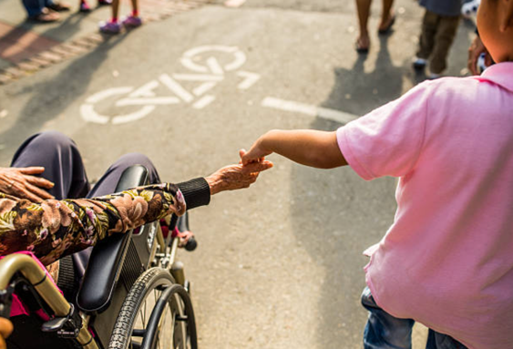
What is compassion?
Compassion means we care about others, treat them with kindness, and want to help people in need.
It is about helping someone when they are in need, for example, if they are suffering, upset, sad or distressed.

Slide 5
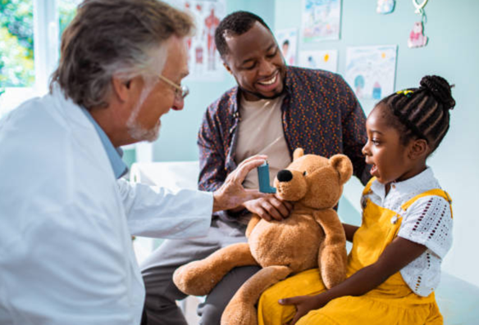
Compassion is…
Caring about other people.
Treating them with kindness.
Wanting to help someone who needs help.

Slide 6
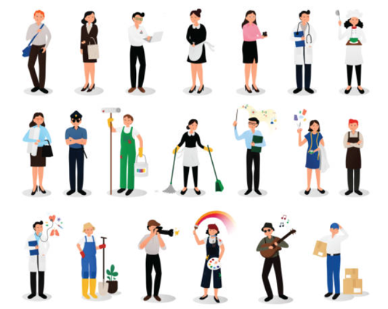
Discussion task
In pairs, can you think of jobs where people help others?

Slide 7
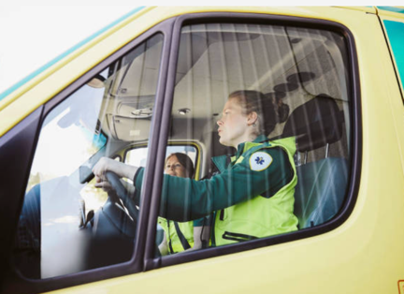
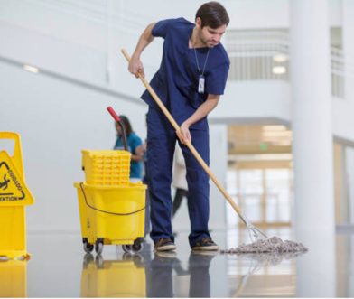
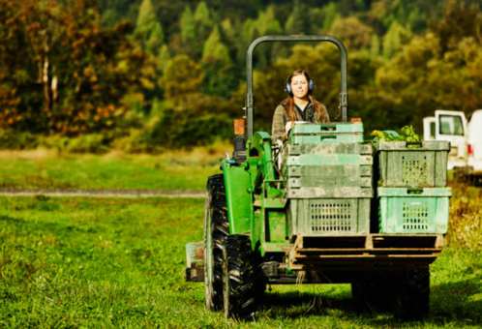
What jobs do you think these people are doing?
Discussion task
Can you explain how they are helping others?

Slide 8
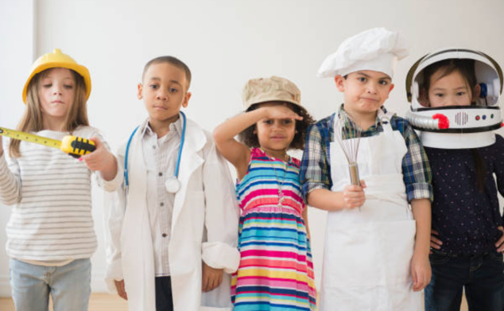
When you are older, you will have a job and it is important that you understand how to show compassion in your job.
Let’s understand what compassion in the workplace could look like.

Slide 9
Compassion in work
This is Rachel. She is a speech and language therapist which means that she helps people who find it difficult to talk.
In this video, Rachel is going to tell you more about her job. She is also going to tell you why compassion is really important.
Make sure you are listening carefully and thinking about what Rachel is saying!
https://youtu.be/9n6W2WEmlbs
Notes:
To support pupils’ understanding, we recommend that you pause the film when each question is displayed and read the question together as a class. The first part of the film is an explanation of the role of a speech and language therapist. Rachel discusses the importance of compassion in her job from 1 minute 50 seconds onwards.

Slide 10
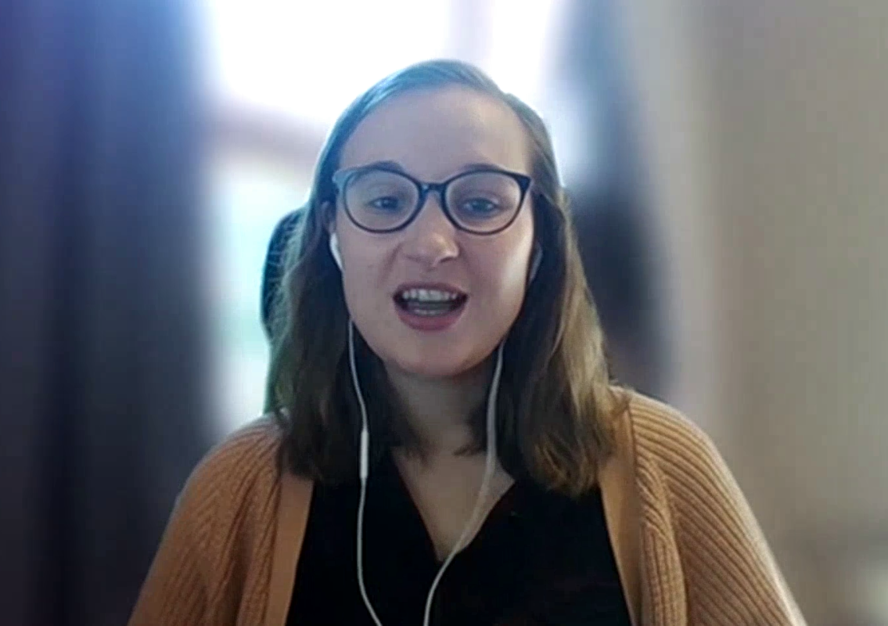
Time to think and talk!
Take a moment to think about what Rachel said.
What is a speech and language therapist?
What does Rachel like about her job?
How does Rachel show compassion when she is working?
A speech and language therapist is someone who…
Rachel shows compassion in her job by…
Rachel enjoys her job because…

Slide 11
You can show compassion…
By helping someone in need.
By caring about their feelings.
By understanding what others may want or need.
By doing something to show you care.
By saying something kind.
By giving someone a hug.
By making them a card.
By listening to others.

Slide 12
Compassion in the workplace could be…
being friendly
speaking to each other kindly
working as a team
making people smile
showing care
listening
being kind

Slide 13
Activity: Draw a job
Draw a picture of a person who helps others in their job.
Explain to a partner how the person you have drawn helps other people.
For example, a piano teacher helps someone to play and read music.

Slide 14
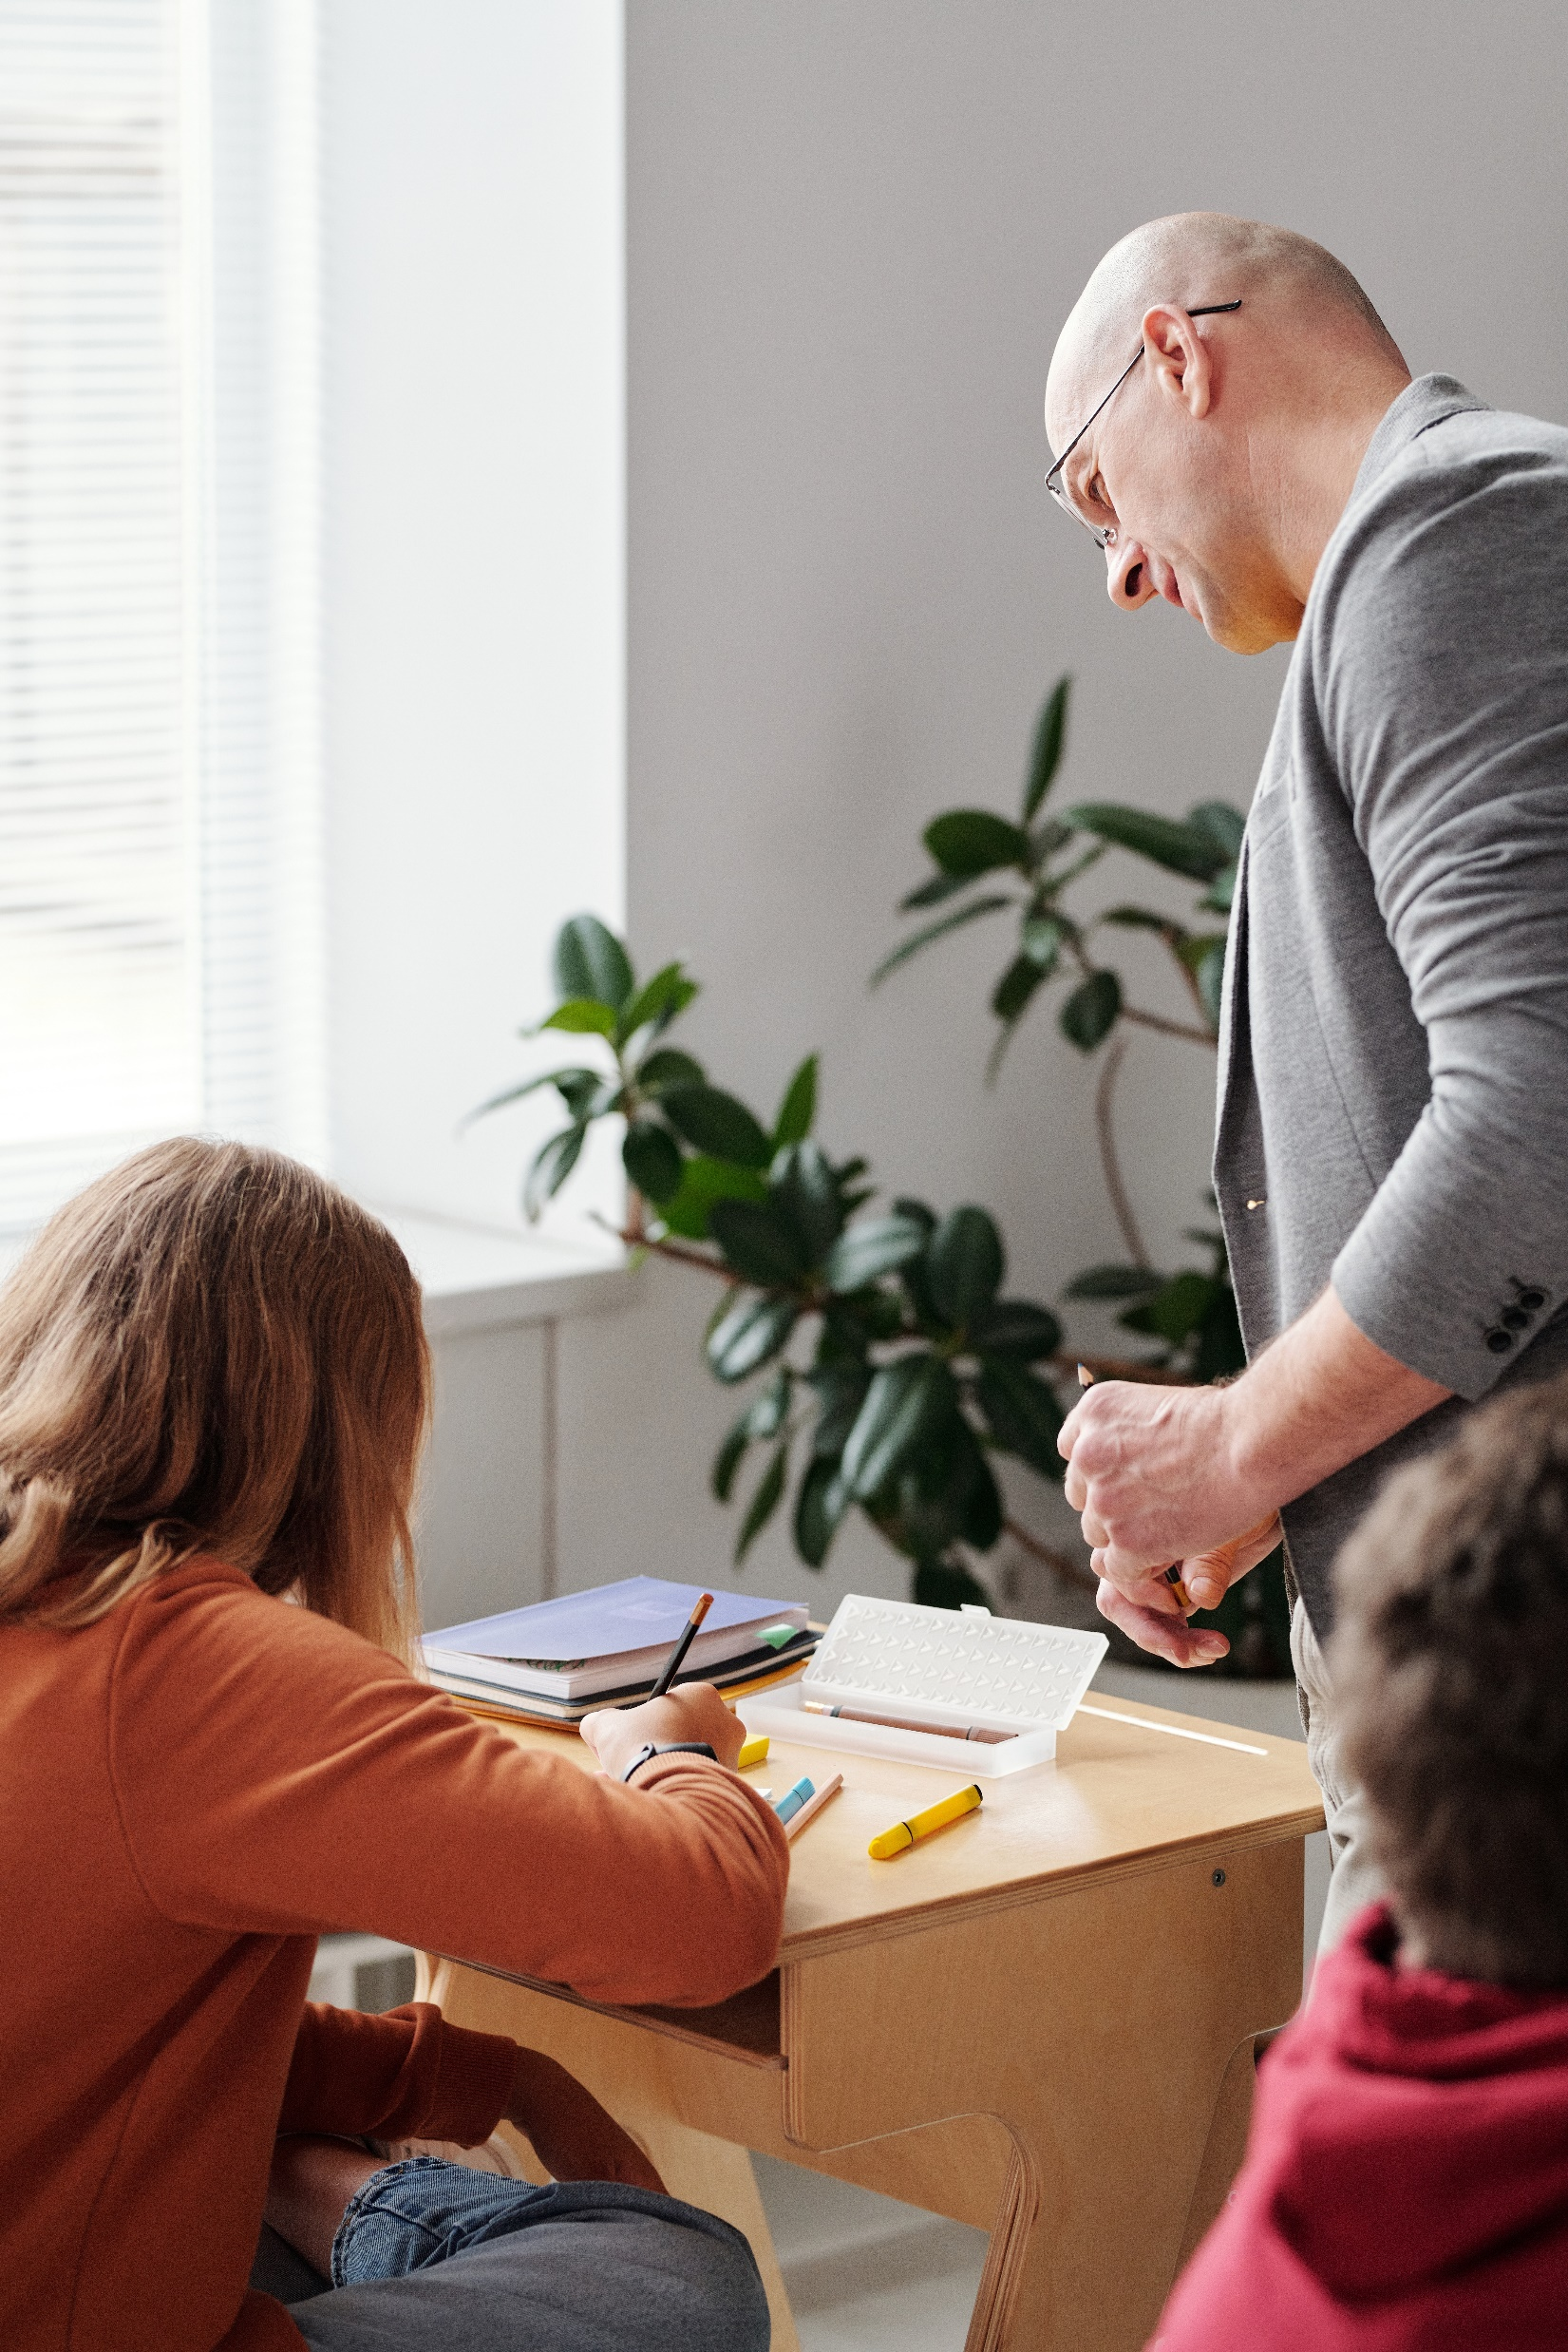
Activity: Act it out
Act out a scene where a teacher shows care to a pupil at school.

Slide 15
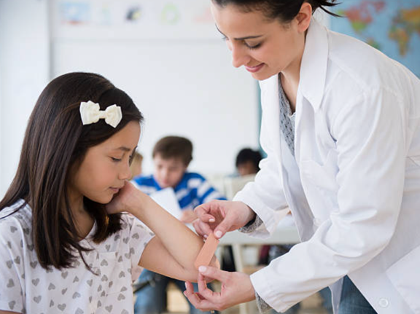
Activity: Act it out
Act out a scene where a doctor shows care to a young patient.

Slide 16
Activity: Act it out
Act out a scene where a firefighter shows care to a child.

Slide 17
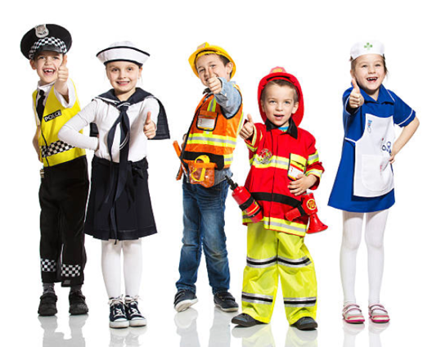
Activity: Helping hand song
Work in a small group to produce a song about helping and caring for others at work.
Think of actions to go with your song.
Use the ideas on the next slide to help you get started.
Be prepared to perform your song to the class.

Slide 18
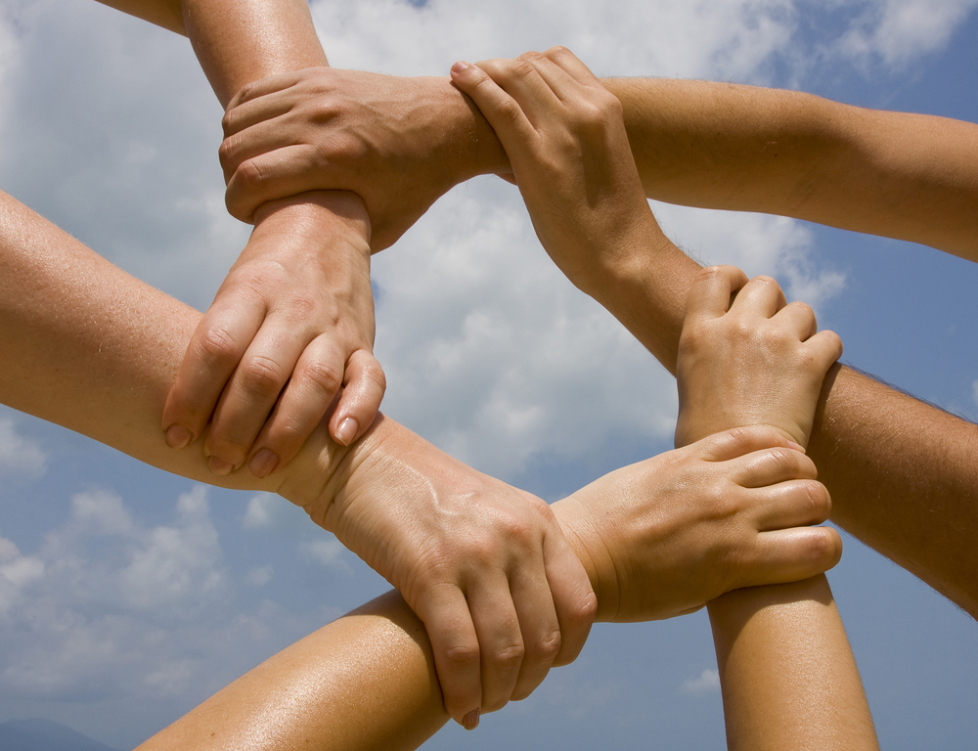
Activity: Helping hand song
You could try using rhyming words like these ones:
You could try using actions like these ones:
care and share
cry and try
give and live
kind and mind

Slide 19
Time to reflect
Why is it important to be kind and compassionate to other people?
Choose someone in your class, or a member of your family, and think of one compassionate thing that you can do for them this week.

Slide 20
Further information
For schools in the PiXL partnership, you can find further PiXL Futures resources, and materials to support the development of compassion, within the Character, Culture, Wellbeing and Futures area on PrimaryWise.
Interested in finding out more about PiXL? Head to our website The PiXL Club - About Us or contact our membership team at membership@pixl.org.uk
You can also help your children to meet more volunteers like the ones in this resource through Primary Futures which is a free resource for state schools. Sign up and log in to invite volunteers into your school from a huge range of sectors to inspire children, raise their aspirations and bring subjects and learning topics to life. Get in touch at enquiries@inspiringthefuture.org

